Slide 1
Smart Public Transport Management
Submitted By:-
Aashay Gandhi
Akshay Chauhan

Slide 2
Why do we need it?
The project helps people to track the bus by GPS and show the occupied and vacant sits in the bus of different routes.
Through this data we get different details of buses that can be used to analyze which route has more passengers in it and get the track of which route is frequently more and which buses are used to get on them.
We can also stop people from entering and leaving the station without a ticket.

Slide 3
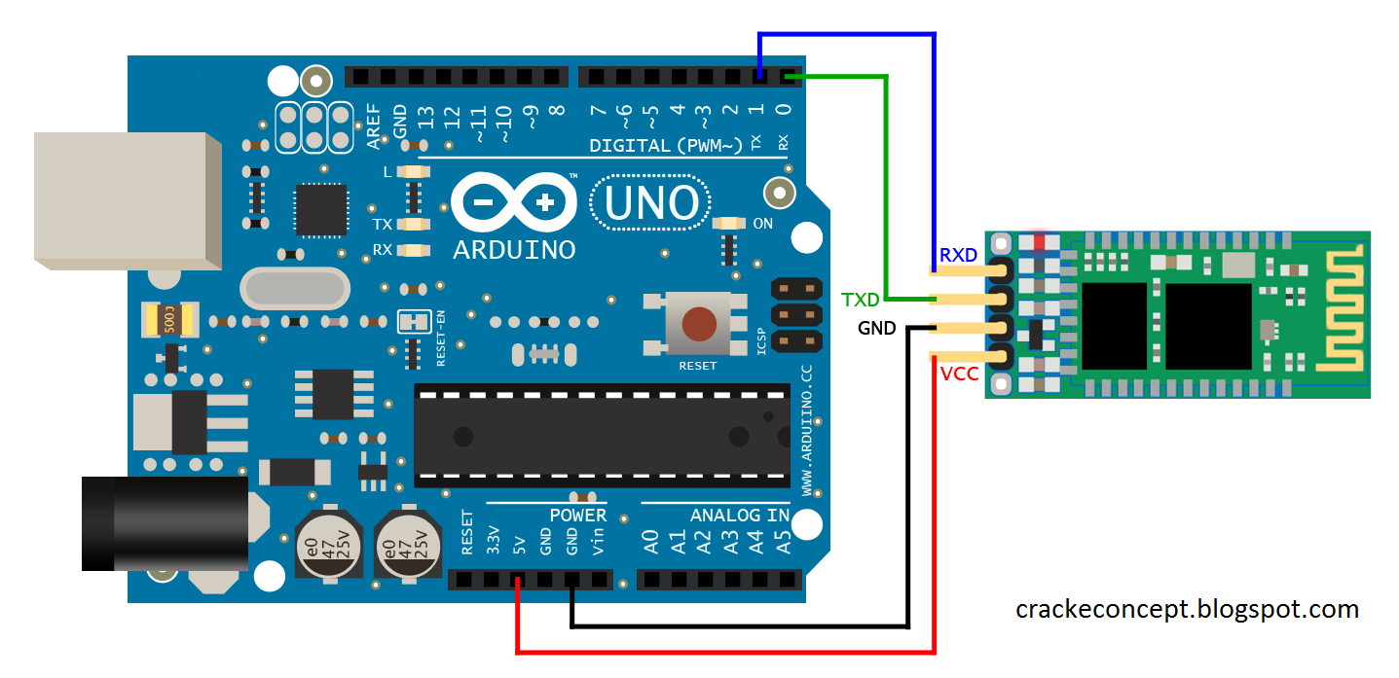
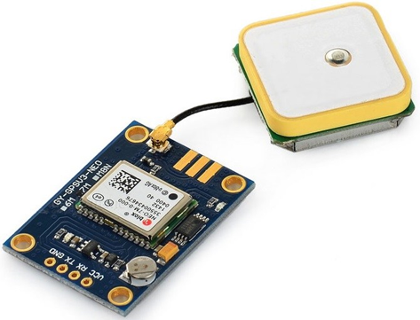
Hardware:- 1) Arduino Uno Board with Bluetooth(HC - 05):-
The Hardware and Software Used:-
2) GPS Neo M6 with Arduino Uno Board

Slide 4






Software:- 1) MIT App Inventor
The Hardware and Software/Technology Used:-
2)Python 3.8
3)Bluetooth technology
4)GPS technology
4)HTML5 CSS3 JavaScript BootStrap4

Slide 5
Process Flow:-
Store the frequency of bus and the passenger details in database
For exit again scan ticket
For entry scan ticket
Generate Barcode ticket for the passenger
Check website for vacant and occupied seats & bus selection
Run python script
Setup the Arduino for Bluetooth and GPS

Slide 6
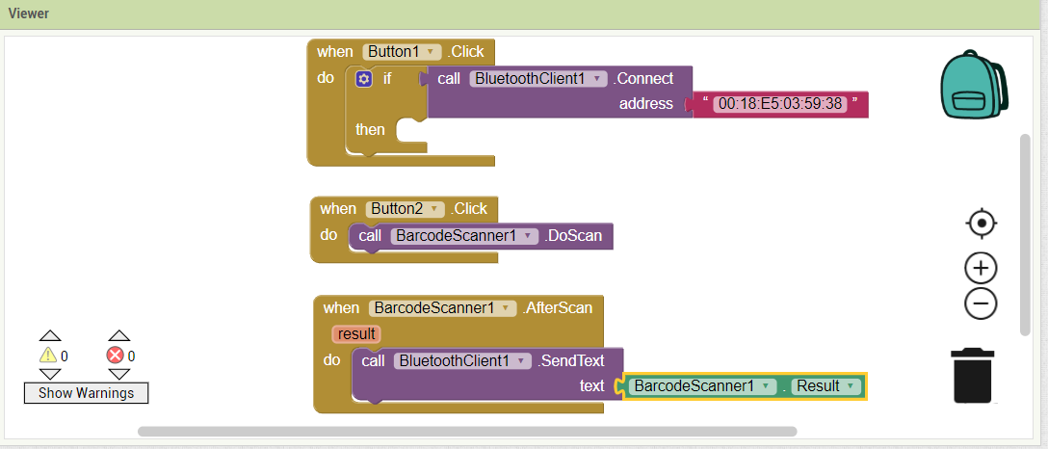
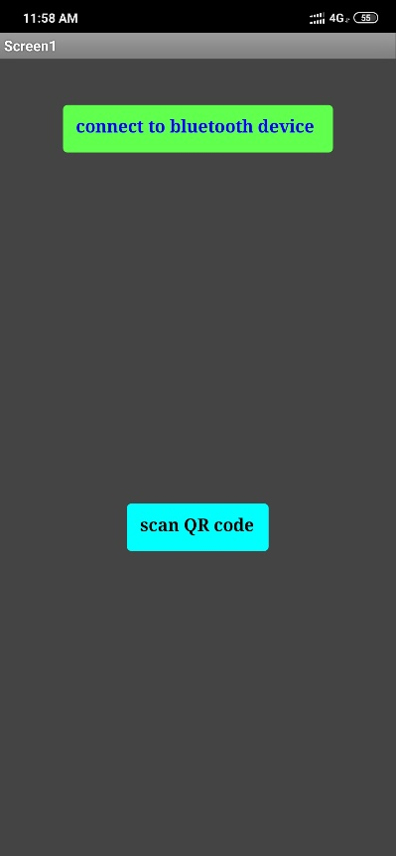
MIT App Design and View
Design:-
View:-

Slide 7
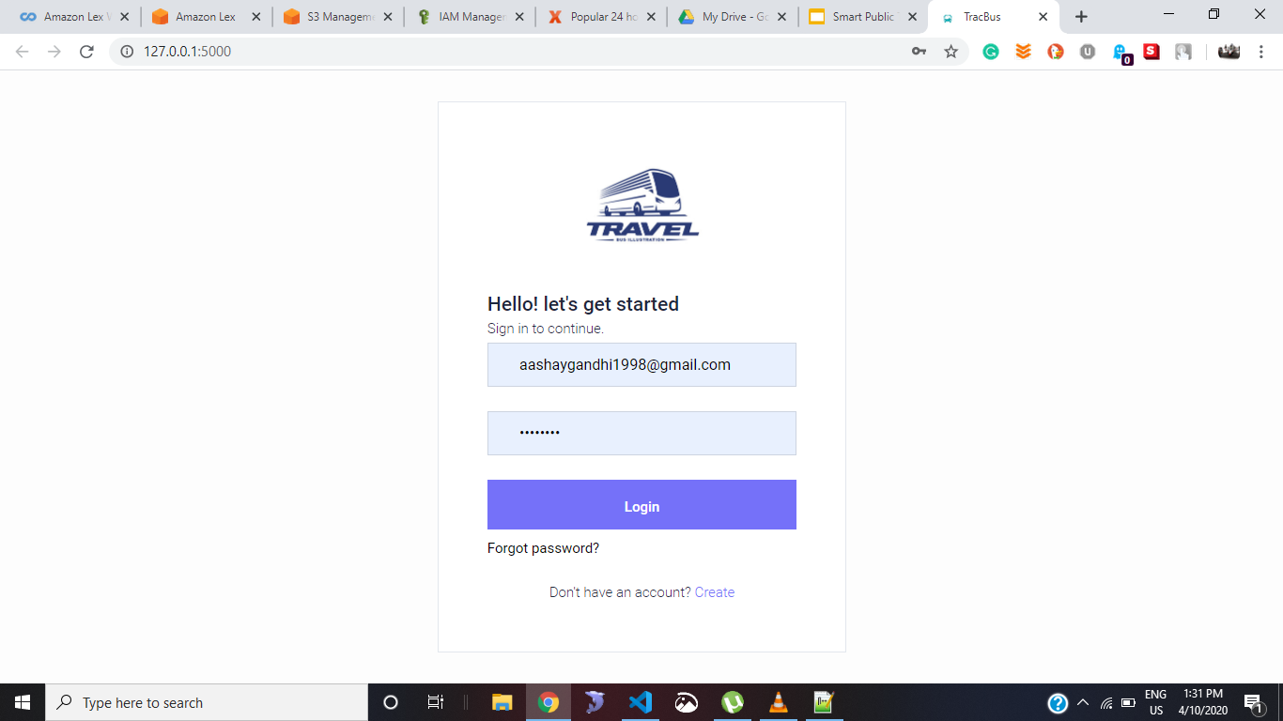
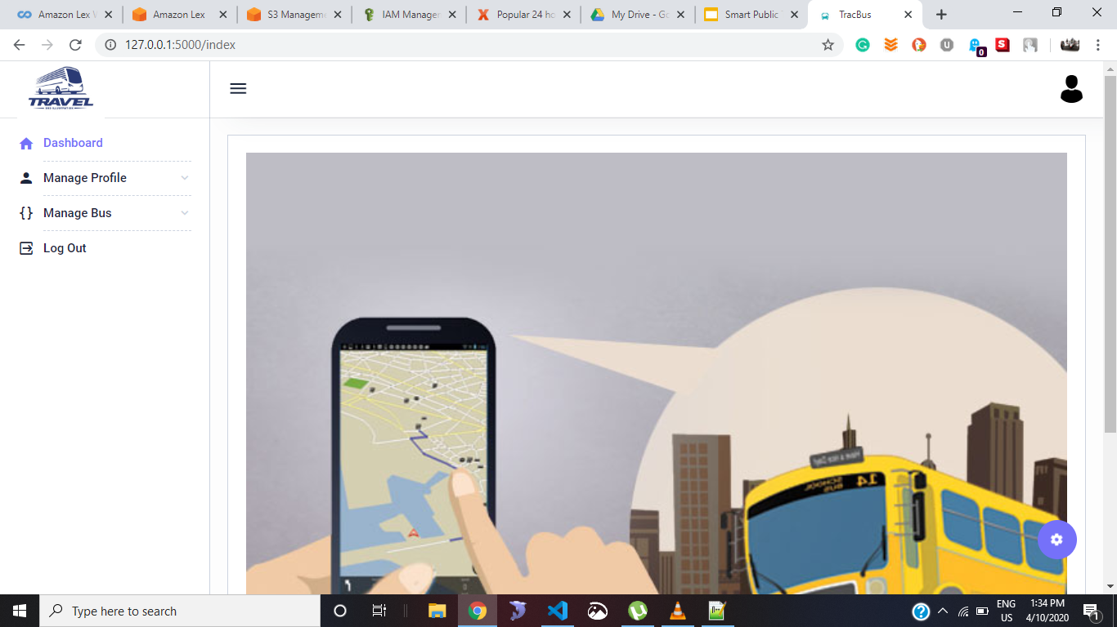
Website Design - Admin side (Login & Index)

Slide 8
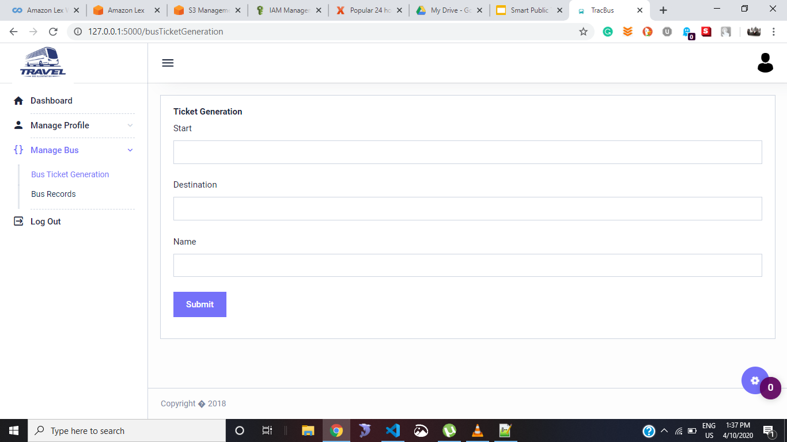
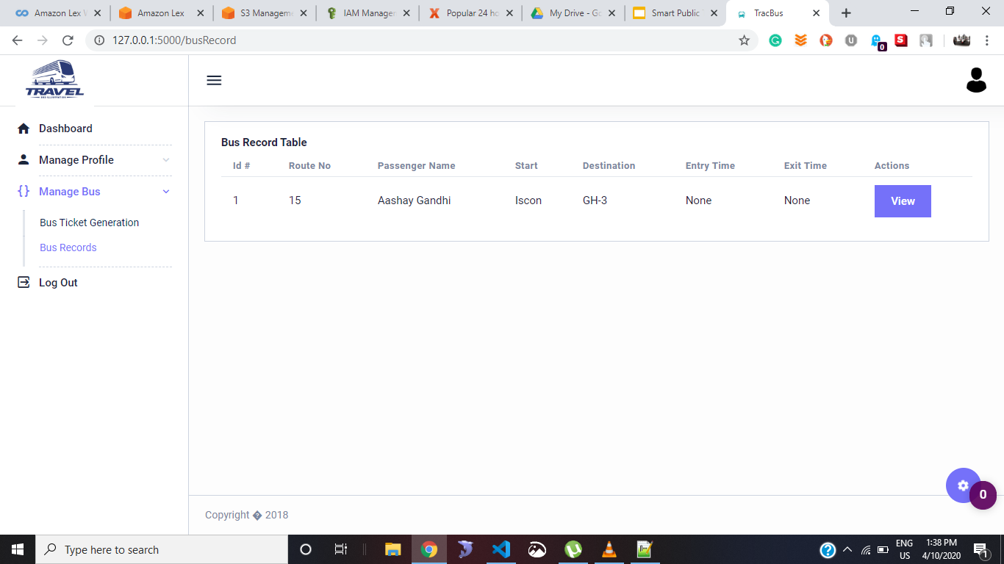
Website Design - Admin side (Ticket Generation & Bus Record)

Slide 9
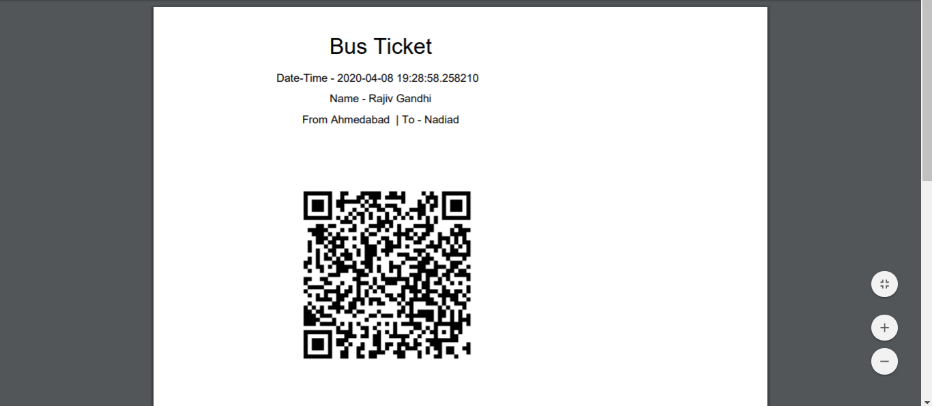
Generated Ticket

Slide 10
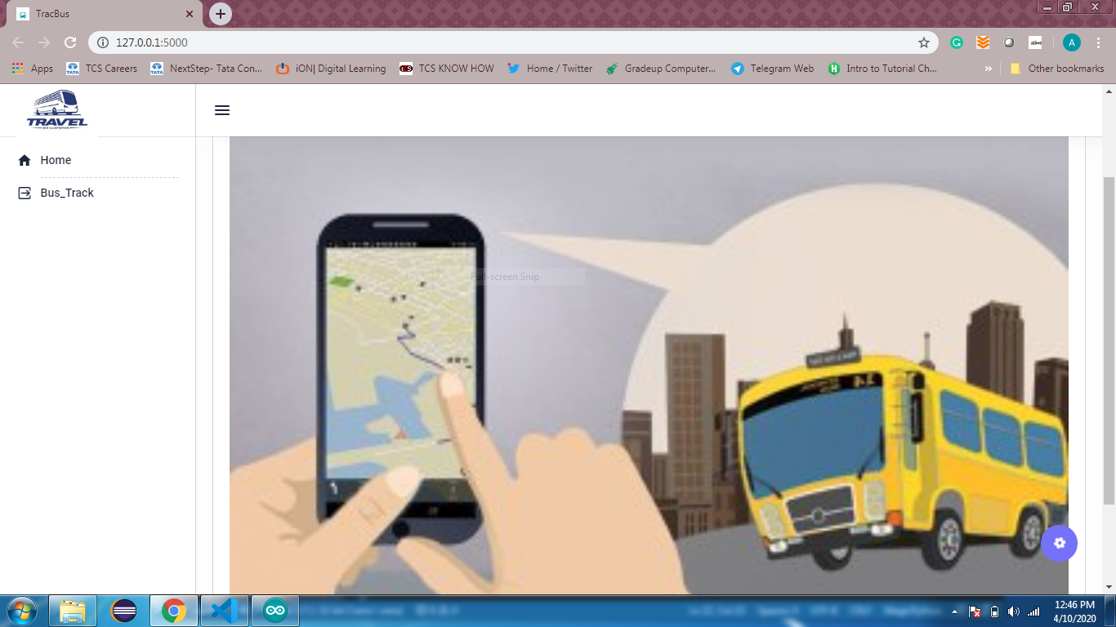
Website Design:- User side Home page

Slide 11
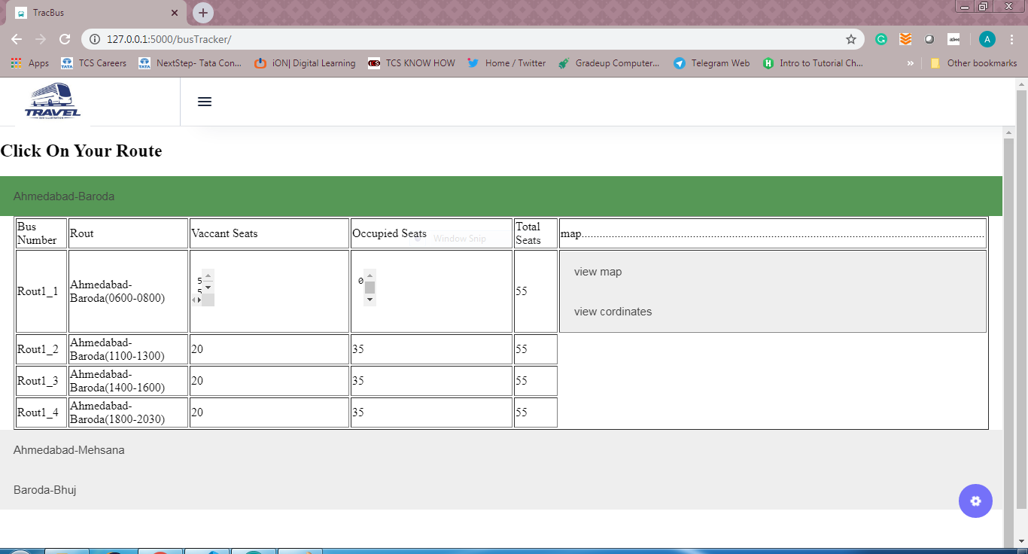
Website Design - User side Bus track

Slide 12
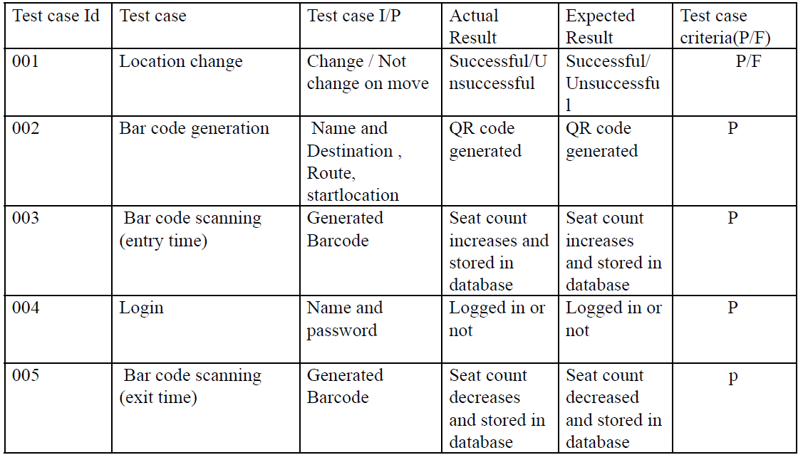
System Test Case

Slide 13
Advantages & Disadvantages
Advantages
Disadvantage
Secure barcode ticket.
The monitor of the ticket bought.
The vacancy and occupied seats in the bus.
The live location of the bus.
Easy to use.
This app only can be used for the single bus for now.
The risk is that a person can go on a bus without scanning the barcode.
The app does not have a payment option.
It depends more on Internet.

Slide 14
Future Scope
This app can be used to link with the Aadhar card and have online payment.
Can be made for multiple buses.
This app can be made by RFID instead of barcode to eliminate that people can go on a bus without a ticket.
The location can be stored in a firebase for continuous location and easy maintainability.
Can host on cloud for better managing of resources.

Slide 15
Conclusion
We propose an idea forward that will help passenger journeys be less tedious and far more efficient for public transport service also. We present a novel idea here that will facilitate everyone a great deal. Not just that it will be helpful for transport to solve the problem like if some bus breaks down it allows other buses from less heavy routes.
It uses an Arduino board connected with GPS which is attached to the bus for showing the real-time position of each bus. We use another Arduino board connected with Bluetooth to connect with devices on the bus for scanning tickets at entry time and exit time.
The ticket generated will be a unique QR code which will be made by taking the Passenger’s first and last name and then the route in which he wants to travel and the destination.

